Slide 1

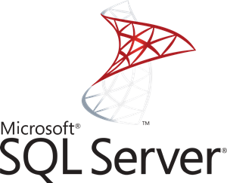

RDBMS MySQL/ PostgreSQL / SQL SERVER
26th Checkpoint
07/03/2022

Slide 2
MySQL (Structured Query Language)
MySQL is an open-source database management system developed by the Oracle Corporation. It is more of a relational database system thus stands as RDBMS. A relational database is a form of database that is formed for storing data in a closely structured format using rows and columns format.

Slide 3
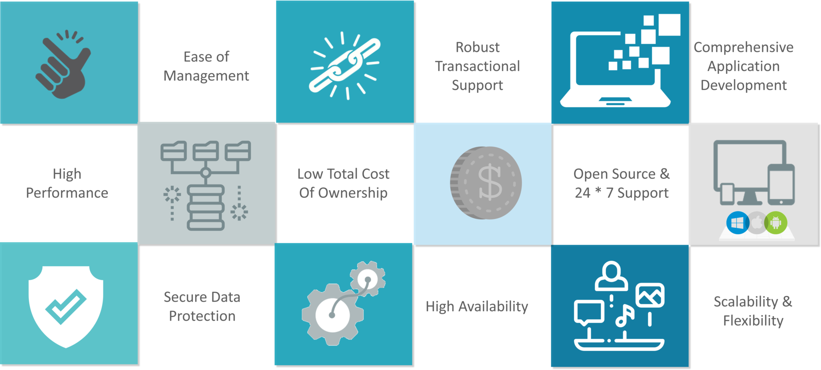
MySQL Features

Slide 4
PostgreSQL
PostgreSQL is a powerful, open source object-relational database system that uses and extends the SQL language combined with many features that safely store and scale the most complicated data workloads.

Slide 5
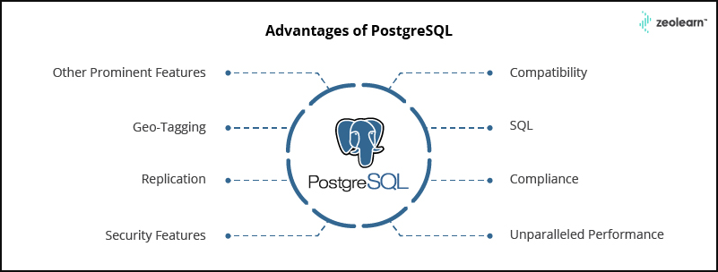
PostgreSQL Features

Slide 6
SQL Server
The SQL Server is a relational database management system from Microsoft. The system is designed and built is to manage and store information. The system supports various business intelligence operations, analytics operations, and transaction processing.

Slide 7
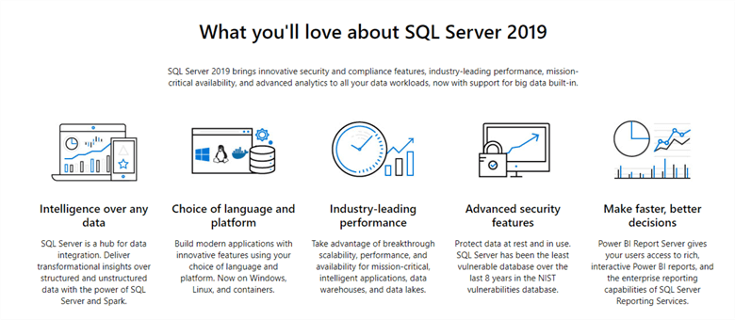
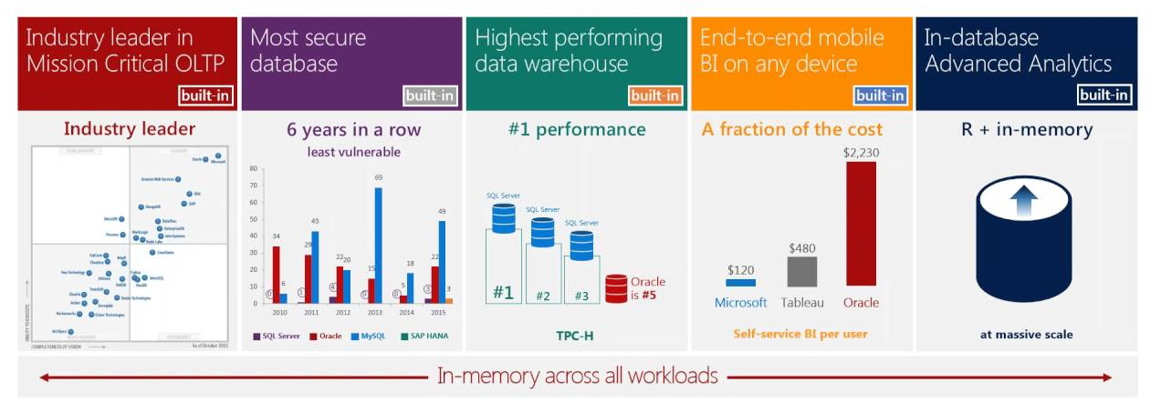
SQL Server Features

Slide 8
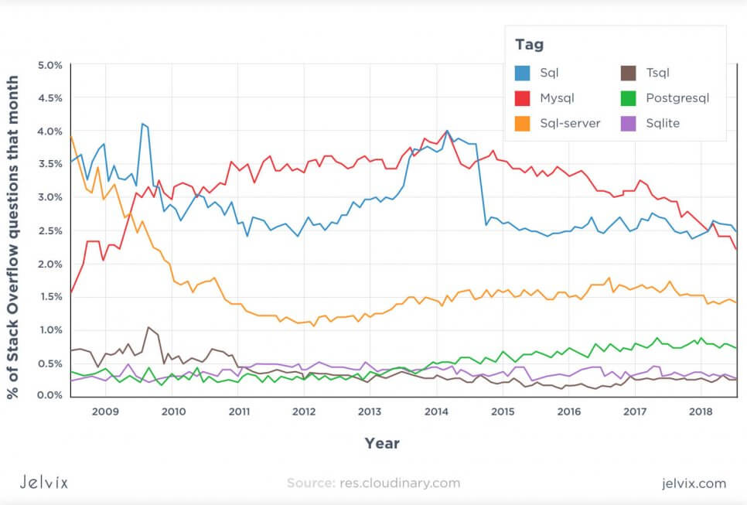
MySQL vs PostgreSQL vs SQL Server: Popularity

Slide 9
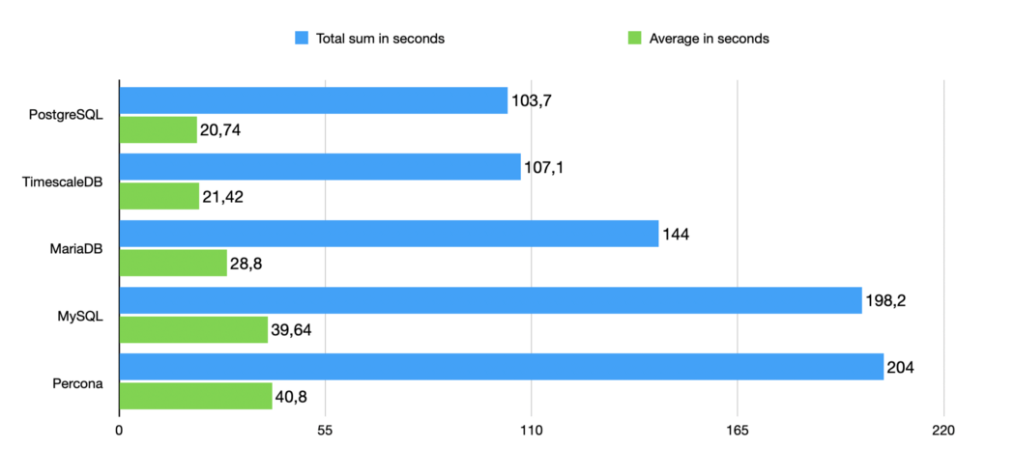
MySQL vs PostgreSQL vs SQL Server: Speed

Slide 10
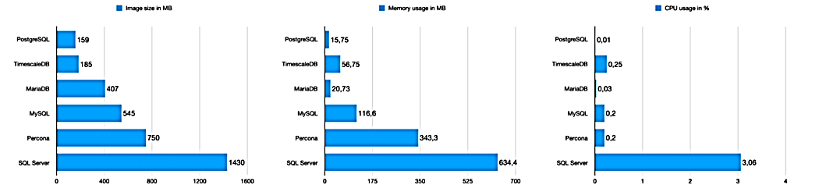
MySQL vs PostgreSQL vs SQL Server: Performance

Slide 11
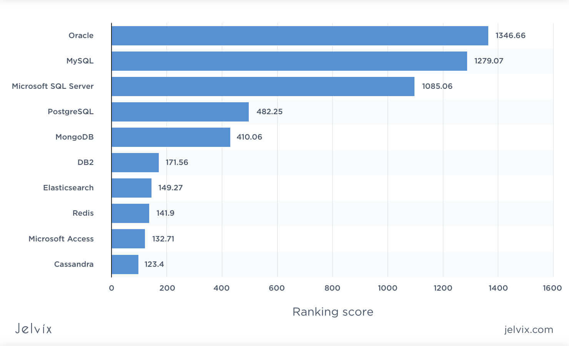
MySQL vs PostgreSQL vs SQL Server: Ranking Score

